Slide 1
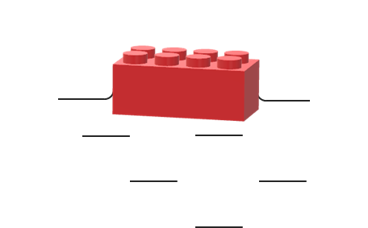
Building bricks
A toy building brick floats on water.

Slide 2
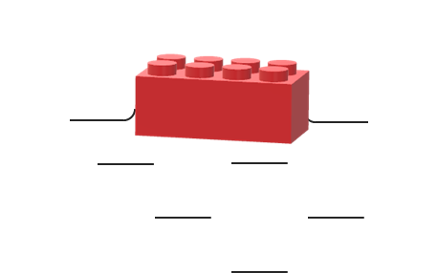
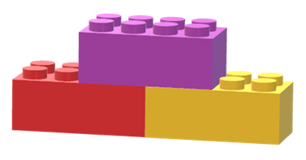
Building bricks
Toy building bricks can be stuck together in a block.
When they are in a block, how many bricks will float?
3 bricks
I am sure this is right
I think this is right
I think this is wrong
I am sure this is wrong
60 bricks
A
A block of three bricks will float.
B
A block of sixty bricks will float.
C
A block of a thousand bricks will float.

